Slide 1

Web Search Engine: Advance Computing Concepts Final Project (COMP8547)
Instructor: Dr. Mahdi Firoozjaei

Slide 2

Team Roles
Arun Reddy Nalla - Hashing, Ranking
110088379
Siddhartha Pitchika - Searching (BoyerMoore)
110089009
Kalyan Venkatesh Poludasu - Spell Check (Edit Distance)
110089120
Veera Venkata Bharat Kumar Vayitla - Crawling, HTML to Text
110088432

Slide 3
Introduction
Flow Diagram
Features
Demo

Slide 4

Web Search Engine
An application created specifically to do web searches is known as a search engine. For any specific information specified in a text-based online search query, they conduct systematic searches of the World Wide Web and return us the weblink which matches the given information.

Slide 5
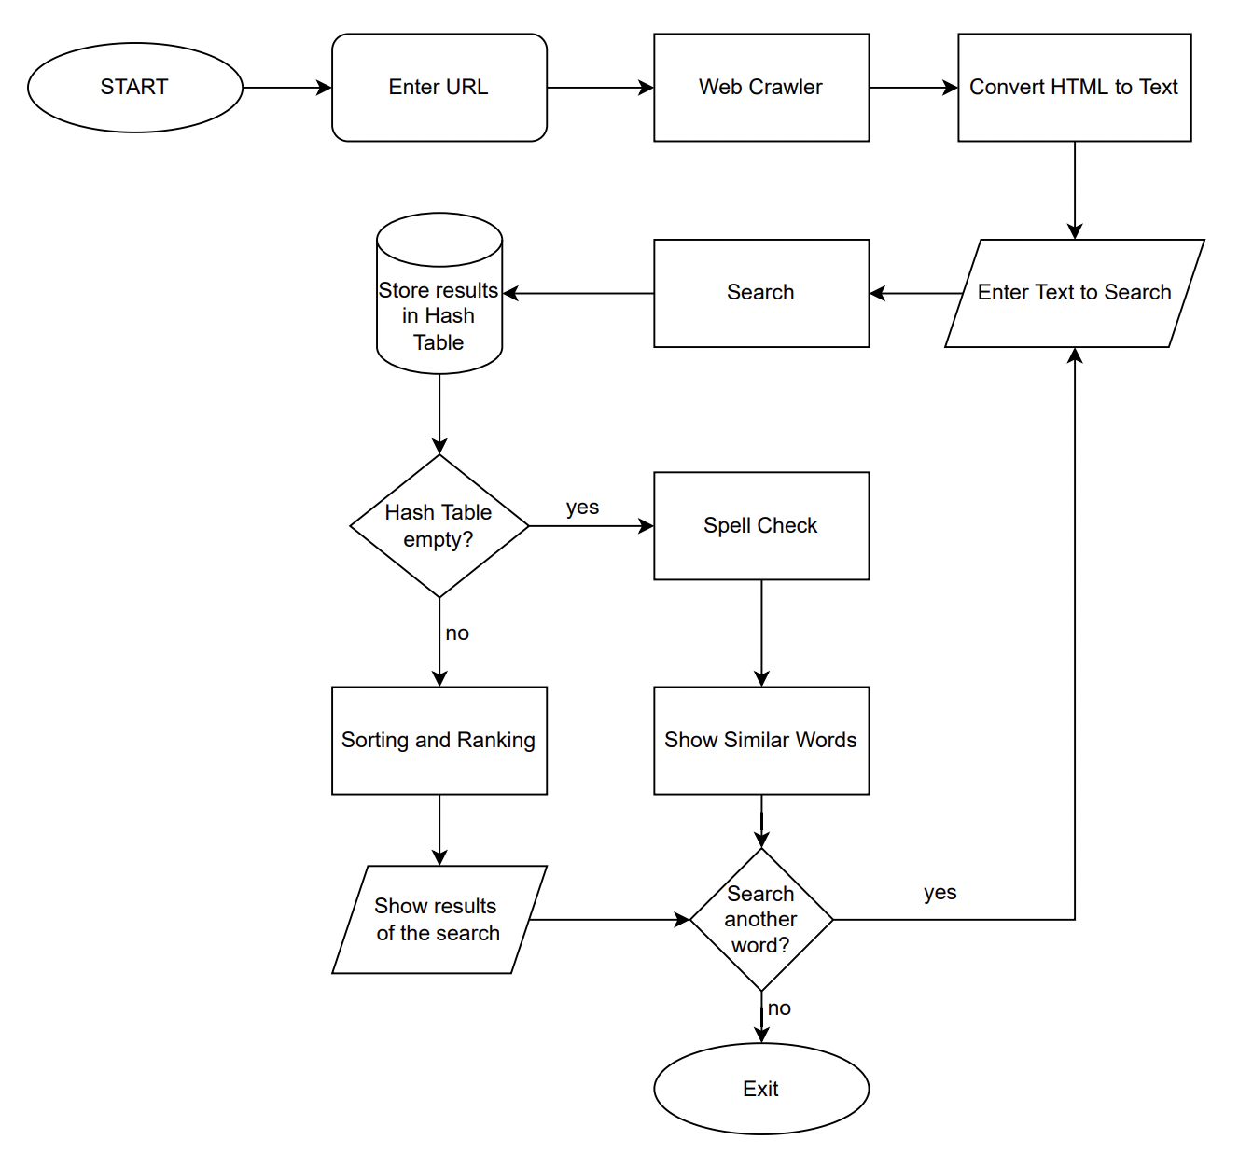
Flow Diagram

Slide 6

Crawler
Discovers and scans HTML from URL​
In our project using href attribute crawls the websites
Crawls and adds them to HashSet if given pattern matched
Jsoup – Library used

Slide 7
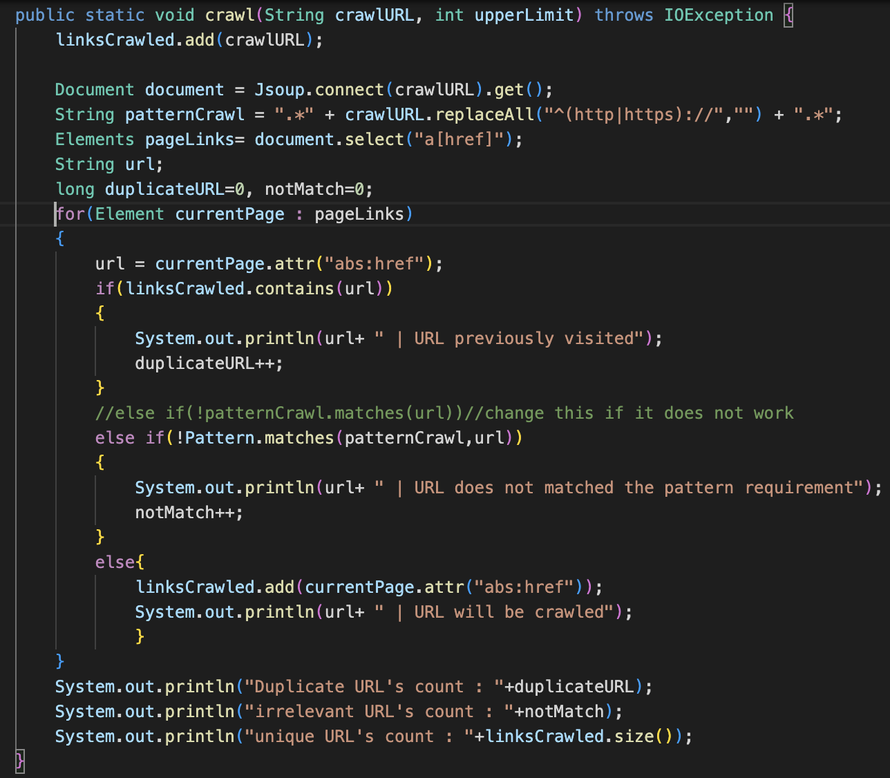
Crawler
Crawls URLs and adds them to Hash Set and prints the count of already visited, unique links and irrelevant

Slide 8

HTML to Text
Now the HTML file will be converted Text file
Gets the URLs from the hash set then it connects and loads the HTML file

Slide 9
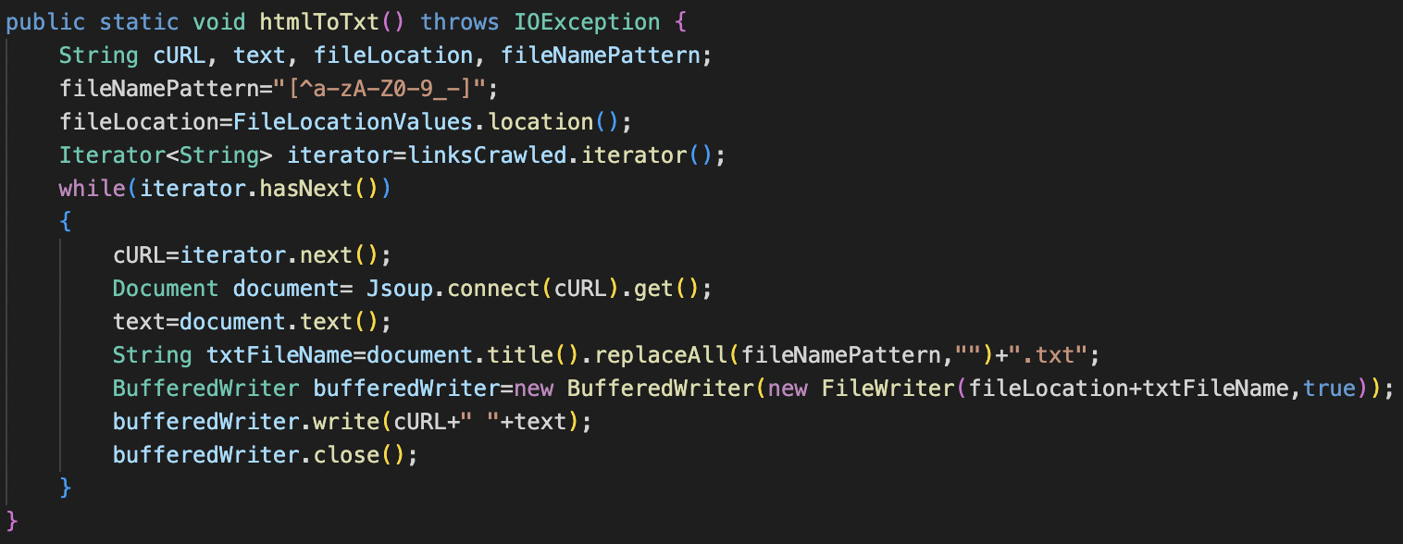
HTML to Text
Now we will Iterate through the links in the Hash Set and connects to that URLs and get the HTML file and converts it to TEXT and saved to the Folder

Slide 10

Searching
Considers the input from the user and searches the input from the text file.
For searching in the input text file, we are using Boyer Moore algorithm.
The algorithm counting the number of times the text appears in each file and storing it in a hash table

Slide 11
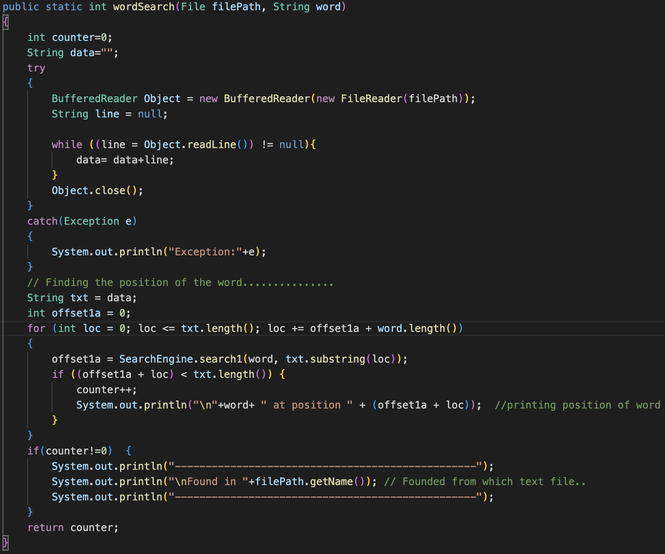
Searching
The words will be iterated and searched in all the text files.
Consider each file to be a set of characters that must be matched using the Boyer Moore Algorithm.

Slide 12
Hashing
The results of a search are stored in a hash table.
File names are recorded as the key, while the number of occurrences in that file is saved as the value.
This hash table is also used for sorting and ranking.

Slide 13
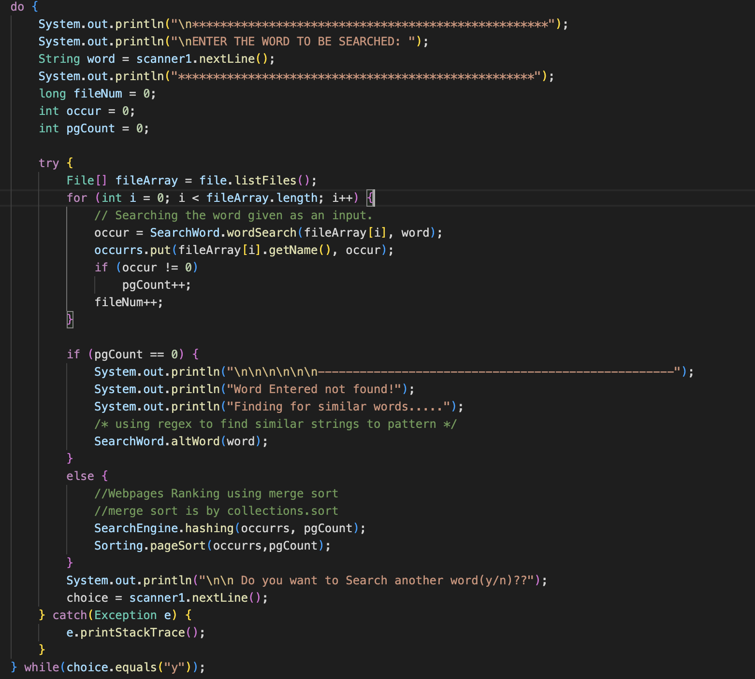
Hash table
Using a separate chaining mechanism, a hash table will save all the records from a search operation.
Once 75 percent of the table is filled, the hash table's capacity will grow.

Slide 14

Ranking
The project shows the url of the webpages where the keyword appears the most frequently and sorts them by frequency.
Sorting algorthim is used for ranking webpages.

Slide 15
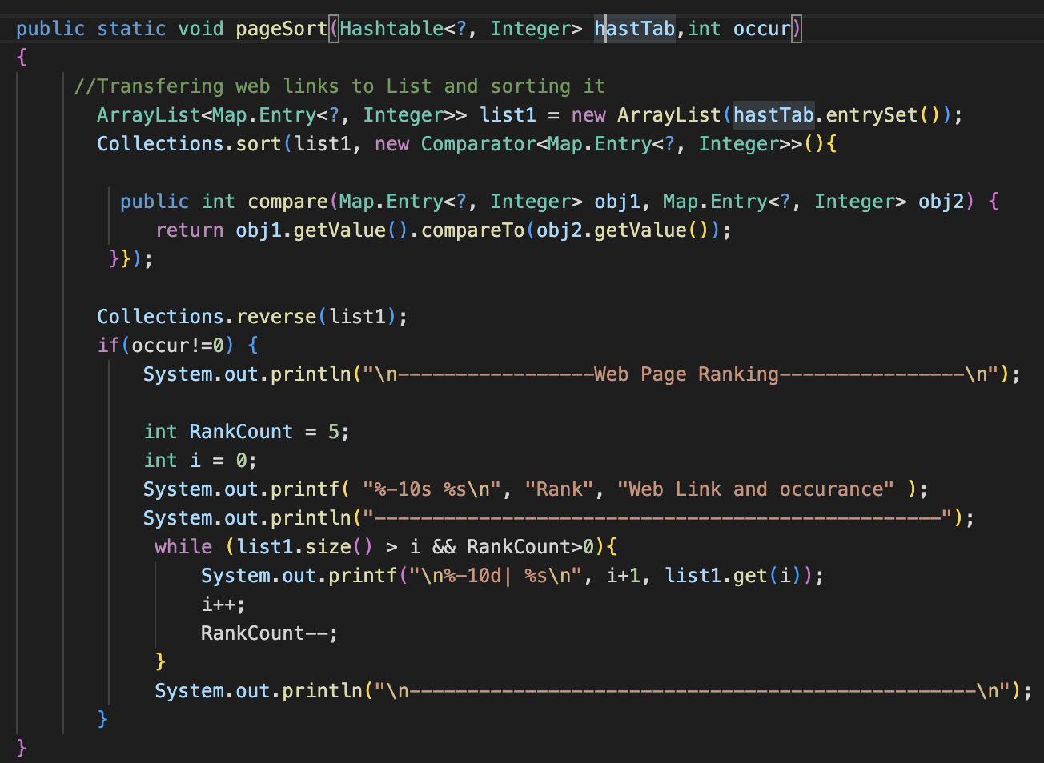
Ranking
Hash Table having URLs will be sorted with respect to the occurrences of the word searched on the web page and Printing the top five web links with occurrence count.

Slide 16
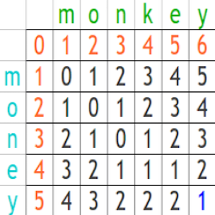
Edit Distance
We get edit distance by calculating how many edit operations are required to change one word to another word.
Operations
Insertion
Deletion
Replacement

Slide 17
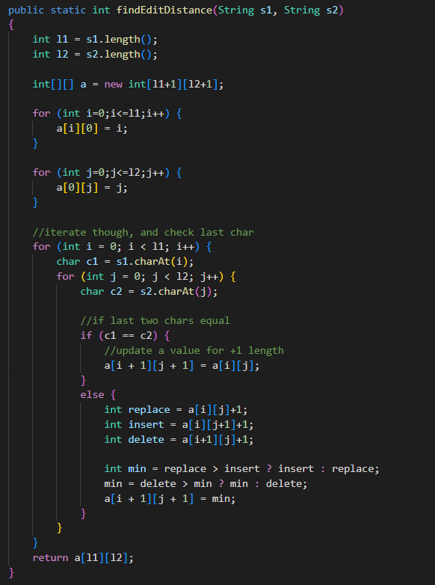
Edit Distance
Tokenizing and storing all text files in a list
The input is matched against each distinct string in the list, and the word with the smallest edit distance is given back as the output.

Slide 18

DEMO

Slide 19

Thank You

